Slide 1
Ridwanul Haque 1721144042
CSE 445
Section: 03
Link: Dataset from Kaggle (5111 * 12)
Project
Stroke Prediction

Slide 2
Problem State:
A stroke is a serious life-threatening medical condition that happens when the blood supply to part of the brain is cut off. According to the World Health Organization (WHO), stroke is the 2nd leading cause of death globally, responsible for approximately 11% of total deaths.
Solution State:
This project is used to predict whether a patient is likely to get stroke based on the input parameters in the dataset like gender, age, various diseases, and smoking status etc using ML approach.

Slide 3
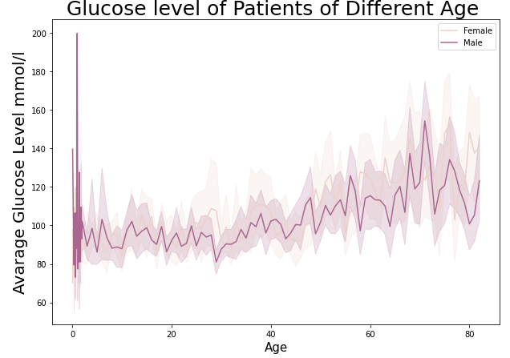
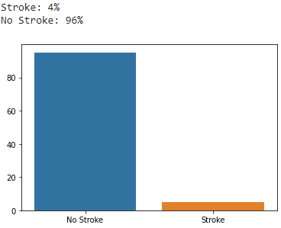
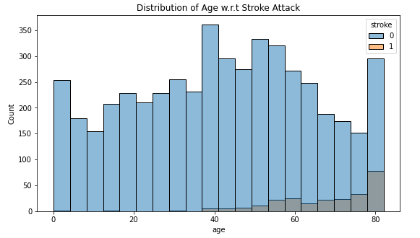
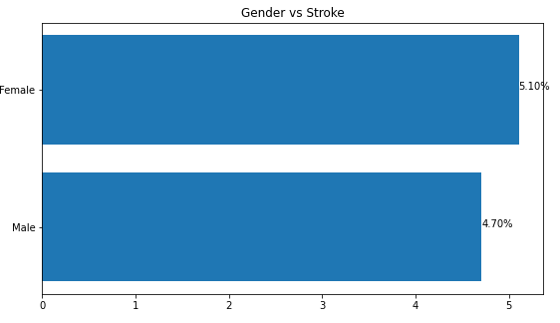
Solution:
1. Observe Dataset and Data Cleaning
Eliminate Unnecessary Colum’s
Dataset Describe
Null Value Identify and Interpolate
Numeric value Conversion of features Variable
Glucose level on Age depending on Gender
2. EDA (Data Visualization)
Stroke vs No Stroke
Stroke on Age
Stroke on Gender

Slide 4
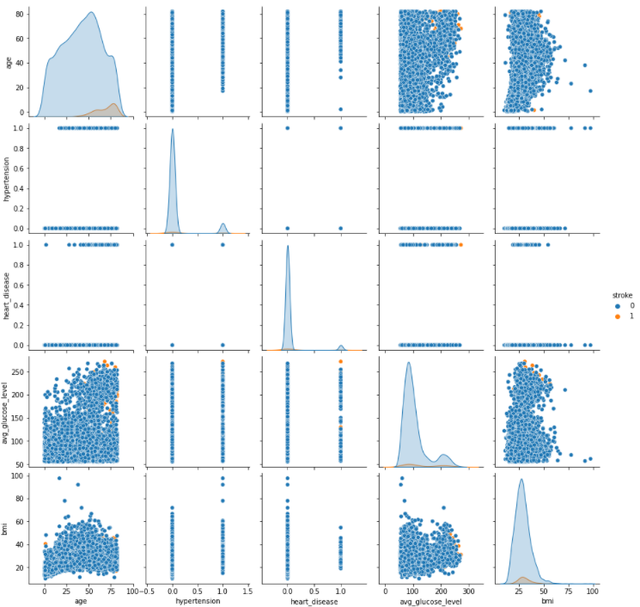
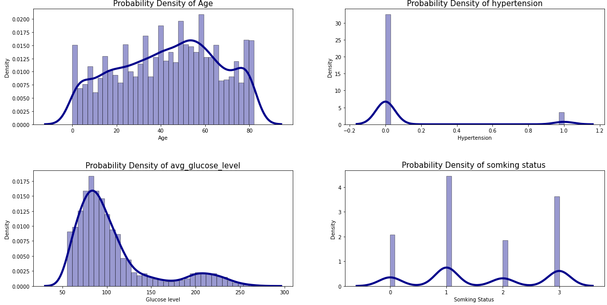
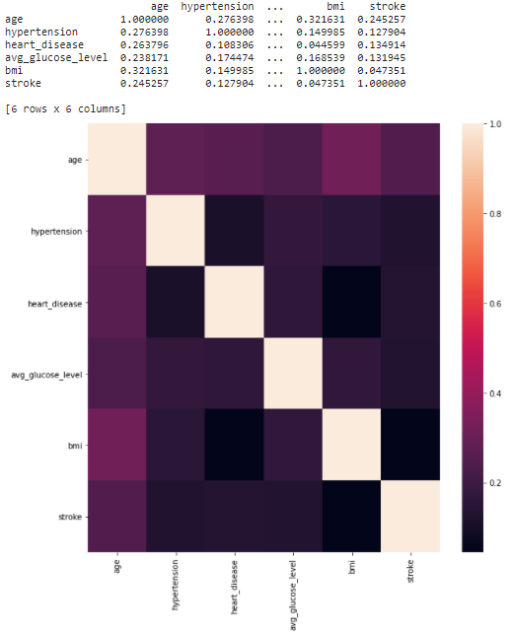
Solution:
Pair Plot on deferent parameters
Probability Density Function depending on deferent parameters.
3. Classification Models
Split dataset into Train and Test (test size=0.4, random state=30)
Fit data set into Models:
Logistic Regression
SVM
Decision Tree
KNN
Random Forest
Heatmap

Slide 5
Results:
Decision Tree
precision recall f1-score support
0 0.96 0.94 0.95 1958
1 0.12 0.19 0.15 86
accuracy 0.91 2044
macro avg 0.54 0.56 0.55 2044
weighted avg 0.93 0.91 0.92 2044
ROC-AUC score: 56.39%
Confusion Matrix:
[[1844 114]
[ 70 16]]
KNN precision recall f1-score support
0 0.96 0.98 0.97 1958
1 0.03 0.01 0.02 86
accuracy 0.94 2044
macro avg 0.50 0.50 0.49 2044
weighted avg 0.92 0.94 0.93 2044
ROC-AUC score: 49.82%
Confusion Matrix:
[[1928 30]
[ 85 1]]
Random Forest
precision recall f1-score support
0 0.96 1.00 0.98 1958
1 0.25 0.02 0.04 86
accuracy 0.96 2044
macro avg 0.60 0.51 0.51 2044
weighted avg 0.93 0.96 0.94 2044
ROC-AUC score: 51.01%
Confusion Matrix:
[[1952 6]
[ 84 2]]

Slide 6
Results:
Logistic Regression
precision recall f1-score support
0 0.96 1.00 0.98 1958
1 1.00 0.01 0.02 86
accuracy 0.96 2044
macro avg 0.98 0.51 0.50 2044
weighted avg 0.96 0.96 0.94 2044
ROC-AUC score: 50.58%
Confusion Matrix:
[[1958 0]
[ 85 1]]
SVM precision recall f1-score support
0 0.96 1.00 0.98 1958
1 0.00 0.00 0.00 86
accuracy 0.96 2044
macro avg 0.48 0.50 0.49 2044
weighted avg 0.92 0.96 0.94 2044
ROC-AUC score: 50.00%
Confusion Matrix:
[1958 0]
[ 86 0]]
Conclusion:
Overall ROC- Accuracy and Accuracy and other score seems Decision Tree is good for this Dataset and for future work. And seems SVM is doing worst.

